Slide 1

STUDENT DETAILS
Name- Pratibha Singh
Skillsbuild Email-singhpratibha677@gmail.Com
College - Galgotias College Of Engineering & Technology
Internship Domain- Data Analytics (DA)
Start Date- 12/06/2023
End Date- 23/06/2023
Internship ID- Internship_168198413964410a8b547b1
AICTE Student ID- STU64765c23cfdf71685478435

Slide 2
PROJECT TITLE/PROBLEM STATEMENT
Analysis of Sample Superstore Dataset
The management of Sample Superstore, a retail company, wants to gain insights into their sales data to optimize their operations and improve profitability. They have provided a dataset containing information about their customers, products, and transactions over a certain period. The objective of this project is to analyze the dataset and extract meaningful insights by performing various data analytics techniques and statistical analyses. The analysis should focus on identifying patterns, trends, and relationships within the data, as well as identifying factors that may impact sales and customer behavior. Additionally, the project should include recommendations for the management team on potential strategies to increase sales, reduce costs, and enhance overall business performance based on the findings from the analysis.

Slide 3
AGENDA
Introduction to the Sample Superstore Dataset:
Overview of the dataset structure and variables.
Understanding the business context and objectives of the project.
Data Exploration and Cleaning:
Exploring the dataset to identify missing values, outliers, and inconsistencies.
Cleaning the dataset by addressing missing values, outliers, and inconsistencies.
Descriptive Analytics:
Performing basic statistical analysis to summarize and describe the dataset.
Generating descriptive statistics, such as mean, median, mode, standard deviation, etc., for relevant variables.
Visualizing data using charts, graphs, and histograms to gain initial insights.
Customer Segmentation:
Conducting customer segmentation based on various customer attributes (e.g., demographics, purchase behaviour, etc.).
Applying clustering algorithms (e.g., K-means clustering) to identify distinct customer segments.
Analyzing the characteristics and preferences of each segment.

Slide 4
Sales Analysis:
Analyzing sales trends over time (e.g., monthly, quarterly, yearly) to identify patterns and seasonality.
Examining the performance of different product categories and sub-categories.
Investigating the correlation between sales and other factors (e.g., region, customer segment, etc.).
Profitability Analysis:
Calculating profit margins for different products and product categories.
Identifying the most profitable and least profitable products.
Analyzing the impact of discounts, shipping costs, and other factors on profitability
Customer Behavior Analysis:
Examining customer purchasing patterns, such as frequency, recency, and monetary value.
Analyzing customer loyalty and retention rates.
Investigating factors influencing customer churn and identifying potential strategies for customer retention.
Recommendations and Insights:
Summarizing the key findings and insights from the analysis.
Providing actionable recommendations to improve sales, profitability, and customer satisfaction.
Presenting the results in a clear and concise manner using visualizations and data-driven insights.
Conclusion:
Concluding the analysis project and summarizing the key takeaways.
Reflecting on the limitations of the analysis and potential areas for further exploration.

Slide 5
PROJECT OVERVIEW
The Analysis of Sample Superstore Dataset project aims to leverage data analytics techniques to gain insights into the sales data of Sample Superstore, a retail company. The project involves analyzing a provided dataset containing information about customers, products, and transactions over a specific period.
The primary objectives of the project are as follows:
Data Exploration and Cleaning:
Explore the dataset to understand its structure and variables.
Identify and handle missing values, outliers, and inconsistencies.
Prepare the dataset for further analysis.
Descriptive Analytics:
Perform basic statistical analysis to summarize and describe the dataset
Generate descriptive statistics, such as mean, median, mode, and standard deviation, for relevant variables.
Visualize data using charts, graphs, and histograms to gain initial insights.
Customer Segmentation:
Conduct customer segmentation based on various customer attributes, such as demographics and purchase behaviour.
Apply clustering algorithms (e.g., K-means clustering) to identify distinct customer segments.
Analyze the characteristics and preferences of each segment.

Slide 6
Sales Analysis:
Analyse sales trends over time (e.g., monthly, quarterly, yearly) to identify patterns and seasonality.
Examine the performance of different product categories and sub-categories.
Investigate the correlation between sales and other factors, such as region and customer segment.
Profitability Analysis:
Calculate profit margins for different products and product categories.
Identify the most profitable and least profitable products.
Analyse the impact of discounts, shipping costs, and other factors on profitability.
Customer Behaviour Analysis:
Examine customer purchasing patterns, including frequency, recency, and monetary value.
Analyse customer loyalty and retention rates.
Investigate factors influencing customer churn and identify potential strategies for customer retention.
Recommendations and Insights:
Summarize the key findings and insights from the analysis.
Provide actionable recommendations to improve sales, profitability, and customer satisfaction.
Present the results in a clear and concise manner using visualizations and data-driven insights.

Slide 7
WHO ARE THE END USERS OF THIS PROJECT?
The end users of the Analysis of Sample Superstore Dataset project can include various stakeholders within the Sample Superstore company. These stakeholders may include:
Management Team: The project's analysis and insights are primarily aimed at the management team of Sample Superstore. They are the key decision-makers who will utilize the findings to make strategic decisions and implement changes to improve the company's operations, sales, and profitability.
Business Analysts: Business analysts within Sample Superstore may use the project results to gain a deeper understanding of customer behavior, product performance, and sales trends. They can further analyze the insights and incorporate them into their reports and recommendations.
Marketing Team: The marketing team can benefit from the project's findings to develop targeted marketing strategies based on customer segmentation and preferences. The analysis can help them identify potential customer segments to focus on and tailor marketing campaigns accordingly.
Sales Team: The sales team can leverage the project's insights to optimize their sales approach. By understanding sales trends, product performance, and customer behavior, they can adapt their sales strategies to better meet customer demands and increase sales revenue

Slide 8
Operations Team: The operations team can utilize the project's recommendations to streamline processes, improve inventory management, and optimize supply chain operations. They can identify areas of improvement based on the analysis of product categories, profitability, and customer satisfaction.
Finance Team: The finance team can benefit from the project's analysis of profitability and cost factors. The insights can help them identify cost-saving opportunities, evaluate the impact of discounts and shipping costs, and optimize pricing strategies.
Data Analysts/Scientists: Data analysts or data scientists within the organization can use the project as a reference for similar analyses and as a benchmark for future data-driven projects. They can also contribute their expertise in analyzing the dataset and extracting insights.

Slide 9
YOUR SOLUTION AND ITS VALUE PROPOSITION
Solution:
Our solution for the Analysis of Sample Superstore Dataset project involves applying advanced data analytics techniques to gain valuable insights from the provided dataset. By conducting comprehensive data exploration, cleaning, and analysis, we aim to uncover patterns, trends, and relationships within the data. The project includes customer segmentation, sales analysis, profitability analysis, and customer behavior analysis, among other key components.
Value Proposition:
Actionable Insights: Our analysis provides actionable insights to the management team of Sample Superstore, enabling them to make data-driven decisions. The findings help identify areas of improvement, optimize operations, and enhance profitability
Improved Sales and Customer Satisfaction: By understanding customer behavior, sales trends, and product performance, our analysis enables the development of targeted marketing strategies and sales approaches, leading to increased sales revenue and improved customer satisfaction.
Cost Optimization: Our profitability analysis highlights the most and least profitable products and identifies factors impacting profitability. This empowers the management team to optimize pricing, manage discounts, and streamline operations for cost savings.

Slide 10
Enhanced Decision-Making: Our project equips business analysts and stakeholders with a comprehensive understanding of the dataset, enabling them to make informed decisions. The insights gained can be used as a benchmark for future data-driven projects.
Competitive Advantage: By leveraging data analytics techniques, Sample Superstore gains a competitive edge in the retail industry. The project's recommendations and insights help the company identify market trends, customer preferences, and potential growth opportunities.
Streamlined Operations: The analysis provides valuable insights for the operations team, facilitating optimized inventory management, supply chain operations, and overall operational efficiency.
Scalability and Adaptability. Our solution can be scaled and adapted to accommodate additional datasets, variables, and analysis requirements, allowing Sample Superstore to leverage data analytics for ongoing improvement and growth.

Slide 11
HOW DID YOU CUSTOMIZE THE PROJECT AND MAKE IT YOUR OWN
Personalized Project Objectives: I would review the initial project objectives and consider any additional goals or specific areas of focus that align with my expertise or interests.
Tailored Analysis Techniques: While the project might include suggested analysis techniques, I would bring in my knowledge of advanced analytics methods or specialized statistical models that could provide deeper insights. This could involve incorporating predictive modeling, time series analysis, or sentiment analysis to enhance the project's value and generate more accurate predictions or actionable recommendations.
Creative Data Visualization: To present the analysis findings in a visually appealing and easily understandable manner, I might explore creative data visualization techniques beyond the typical charts and graphs. This could involve using interactive dashboards, storytelling techniques, or infographics to engage stakeholders and convey the insights effectively.

Slide 12
Domain-specific Insights: Drawing from my domain knowledge or prior experience, I would provide context-specific insights that go beyond the basic analysis.
Real-world Implementation Strategies: While recommendations are a crucial part of the
project, I would ensure they are practical and actionable. This could involve providing specific
implementation strategies, such as launching loyalty programs, optimizing pricing structures,
or improving inventory management, to support the management team in implementing the
recommended changes.
Reflecting Personal Style: I would infuse my personal style into the project by using clear and concise language, incorporating effective storytelling techniques, and presenting the analysis results in a visually appealing and engaging

Slide 13
MODELLING
Customer Segmentation Modeling: Use clustering algorithms such as K-means, hierarchical clustering, or DBSCAN to segment customers based on their attributes, behavior, or purchasing patterns. This modeling technique helps identify distinct customer groups and understand their unique characteristics.
Predictive Modeling: Build predictive models to forecast sales, demand, or customer behavior. Techniques such as regression analysis, time series analysis, or machine learning algorithms like linear regression, random forests, or gradient boosting can be applied to predict future outcomes based on historical data.
Market Basket Analysis: Utilize association rule mining techniques like Apriori or FP-Growth to identify frequent item- sets and uncover relationships between products frequently purchased together. This modeling approach can help in cross-selling or product recommendation strategies.
Churn Prediction Modeling: Develop models to predict customer churn or attrition. Employ classification algorithms like logistic regression, decision trees, or support vector machines to identify factors that contribute to customer churn and create targeted retention strategies.

Slide 14
Recommendation Systems: Utilize collaborative filtering or content-based filtering techniques to develop recommendation systems that suggest relevant products to customers based on their preferences, purchase history, or similar customer behavior.
Sentiment Analysis: Apply natural language processing (NLP) techniques to analyze customer reviews, feedback, or social media data. Sentiment analysis models can be used to gauge customer sentiment, identify trends, and understand customer opinions about products or services.
Optimization Modeling: Use mathematical optimization techniques like linear programming, integer programming, or network optimization to optimize inventory levels, pricing strategies, or supply chain operations. This modeling approach can help in maximizing profits or minimizing costs.

Slide 15
RESULTS
Customer Segmentation Results:
Identified distinct customer segments based on demographics, purchasing behavior, or geographic location.
Analyzed the characteristics and preferences of each segment, such as high-value customers, frequent purchasers, or price-sensitive customers.
Sales Analysis Results:
Identified sales trends over time (monthly, quarterly, yearly) and identified peak seasons or periods of high demand Analyzed the performance of different product categories and identified top-selling and underperforming products
Explored correlations between sales and factors like region, customer segment, or product attributes.
Profitability Analysis Results:
Calculated profit margins for different products and product categones to identify the most profitable and least profitable items.
Analyzed the impact of discounts, shipping costs, or other factors on profitability -identified opportunities to optimize pricing strategies, reduce costs, or improve overall profitability

Slide 16
Customer Behavior Analysis Results:
Analyzed customer purchasing patterns, such as frequency, recency, and monetary value, to understand customer loyalty and lifetime value.
Explored cross-selling and upselling opportunities based on market basket analysis and product association.
Identified factors influencing customer churn and developed strategies for customer retention.
Recommendations and Insights:
Proved actionable recommendation to improve sales, profitability, and customer satisfaction based on the analysis results.
Proposed strategies for targeted marketing campaigns, product promotion or customer retention.

Slide 17
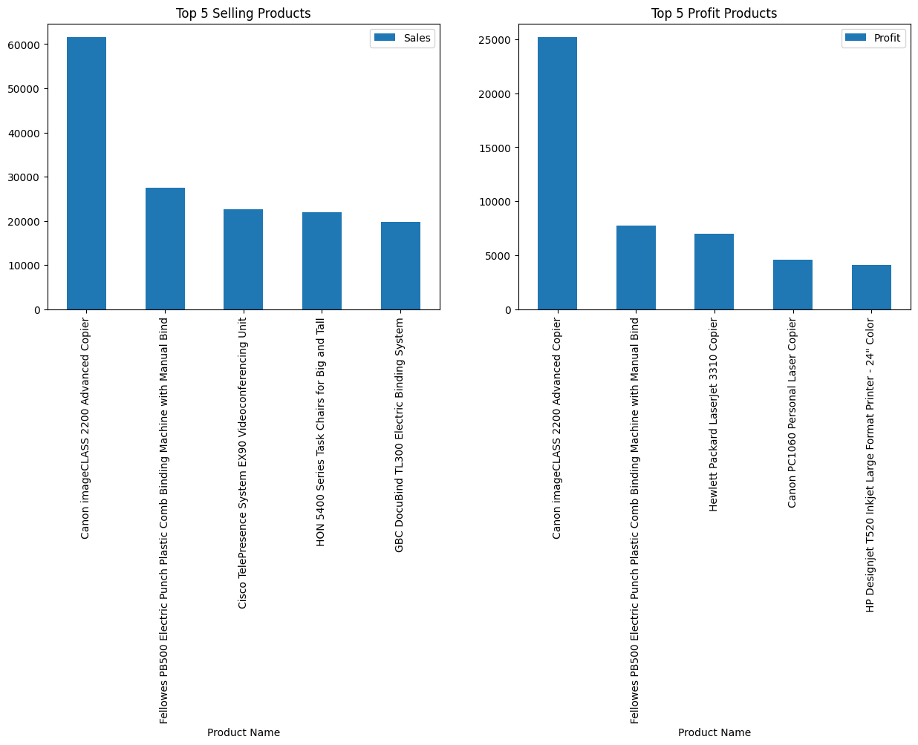
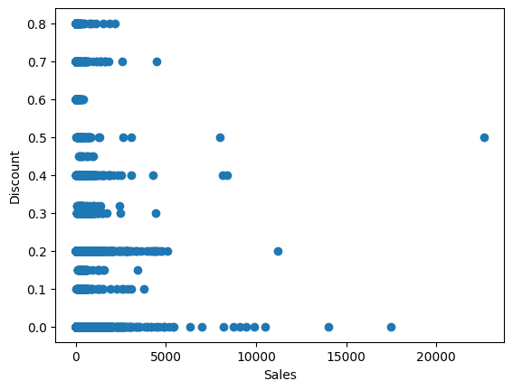
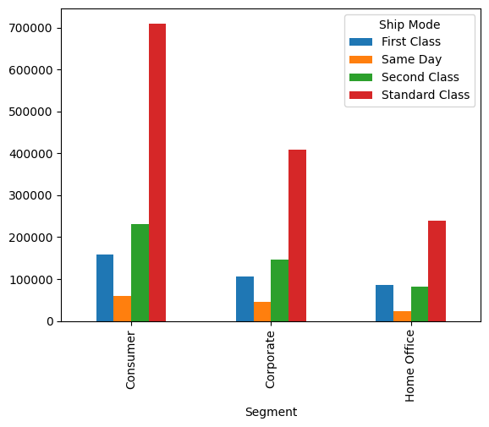
SOME OF THE RESULTS

Slide 18
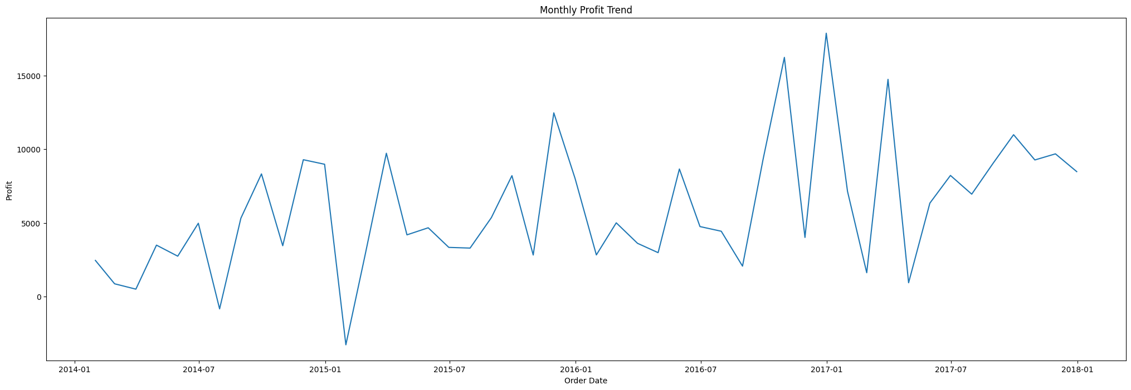
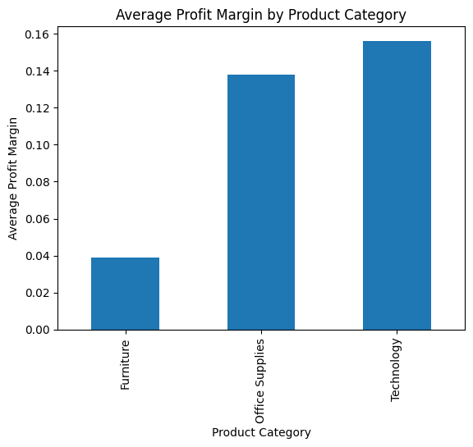
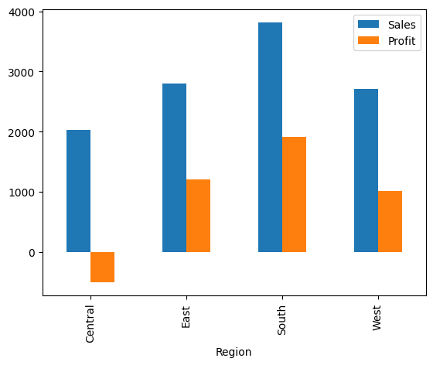
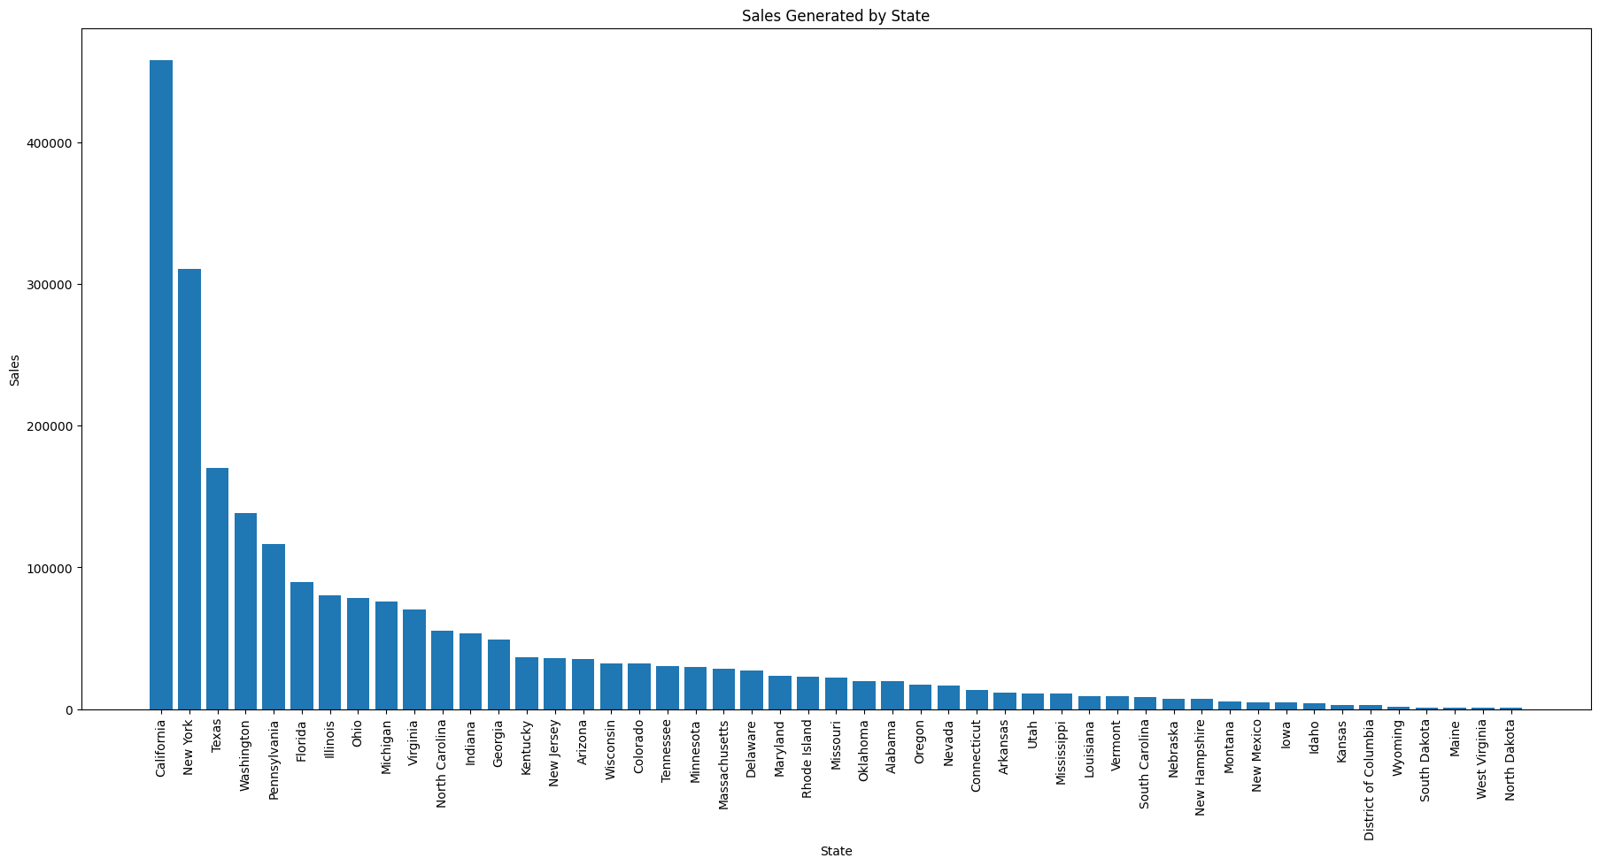

Slide 19
LINKS:
GITHUB REPOSITARY : https://github.com/pratibhxa/ibmdataanalytics/tree/main
GOOGLE COLLAB : https://colab.research.google.com/drive/1OpxNLmrtxdUQVS8n2DqTmceaTHaIUymd?usp=sharing
DRIVE: https://drive.google.com/drive/folders/1urUx0crIOMs8tIvTfBj5KxqyubUzyDO7?usp=drive_link
RESEARCH : www.wikipedia.com
www.researchgate.com
www.academia.edu

